Slide 1
Topic 1:
Introduction and Basics of Data
STOR 155: Introduction to Data Models and Inference
Dr. Teressa Bergland
Fall 2025

Slide 2
Introductions
Welcome to STAT 155! Your first question: Who IS Dr. Bergland?
About me (T/F):
I am an introvert.
I have two cats.
I am a knitter.
I am a pianist.
I am a Carolina Hurricanes fan.
I prefer science fiction to fantasy.
Answers:
True
True! I can bring photos
False… but I do quilt!
True, mostly in musicals
False – Go Penguins!
False. Dragons any day.

Slide 3

Important Syllabus Items: Logistics
Textbook: Open-source and therefore free! Available on Canvas.
Homework: STOR 155 uses WebAssign for homework, which costs money You can purchase semester-long access via the bookstore or online
Use the syllabus link to enroll in our WebAssign section by Tuesday!
  (That way we have a bit of time to solve any problems that may occur)
First assignment will be due Thursday, January 15, 11:59pm!
Attendance: Attendance is mandatory and part of your grade. I will start using PollEverywhere for attendance on Thursday, January 15
Take the syllabus quiz on Canvas by Wednesday for a bonus attendance point!

Slide 4
Important Syllabus Items: Resources
Dr. Bergland’s Office Hours: Hanes 310, Mondays 10-1 and Wednesdays 1-4
Drop by to ask questions, get advice, or just to say hello!
Piazza: A full-class discussion board, shared by my two sections of STOR 155
Piazza (not email) is the best way to reach me outside office hours!
Tutorial sessions: They’re free! They’re open to all! They’re led by experienced instructors! They start Monday, January 19 and run every night Sunday-Thursday!
Held virtually – Zoom link will be posted on Canvas
Need accommodations? Let me know ASAP! The sooner I know what you need, the better I can be prepared to help.

Slide 5
What to Expect in Lecture
Blank lecture notes: These PDFs are provided in advance for you to print or access on the device of your choice. They include lots of blank space for notes.
I will mostly lecture using the chalkboard – taking notes is up to you.
Where to find them: on Canvas, go to the Modules tab. Each module is divided into Topics. The blank notes can be found on each Topic page before lecture.
Slideshows: Slide decks will mostly be used for images, interactive elements like PollEverywhere, and exercises where we pause to think, discuss, and synthesize.
Slide decks will also display headings from the blank notes to help guide you during the lecture.
Slide decks will NOT contain detailed notes!
Let’s see an example of how this will work!

Slide 6
Course Overview
What will we learn in STOR 155?
Steps of inquiry:
Identify a question or problem of interest
Collect relevant data
Analyze the data
Form a conclusion

Slide 7
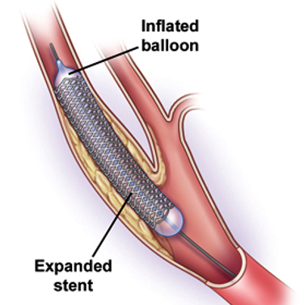
Case Study: Stents
Do stents reduce the risk of stroke in at-risk patients?
 | Stroke | No Event
Treatment | 45 | 179
Control | 28 | 199
Notes:
Doctors wanted to know if placing stents in obstructed arteries would reduce risk of stroke. They placed 224 patients at risk of experiencing a stroke in a treatment group (receiving stents), and 227 in a control group (not receiving stents)
NOTE: compute percentages BEFORE next slide

Slide 8
Let’s try a poll!
Do you find this study data surprising?
For future polls, you’ll need a PollEverywhere account! If you don’t have one yet, go to https://edtech.unc.edu/service/poll-everywhere/ for instructions.
I will start running polls this way next week! We’ll do a test run on Tuesday before using it for attendance.
 | Stroke | No Event
Treatment | 45 | 179
Control | 28 | 199

Slide 9
Case Study: Stents
The Big Question: Do we have enough information to conclude that stents change the risk of stroke in this type of patient?
Test poll!
Flip a coin – physically or virtually – and report the result.
(To flip a virtual coin, just Google “Flip a coin”)

Slide 10
Case Study: Stents
The Big Question: Do we have enough information to conclude that stents change the risk of stroke in this type of patient?
We use statistical tools to determine if the difference is so large that we should reject the notion that it was due to chance.

Slide 11
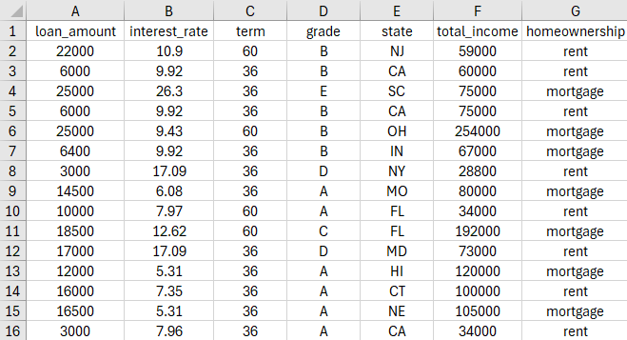
Data Sets: Vocabulary

Slide 12
Data Sets: Vocabulary
Two types of variables:
Numerical
Categorical
Discrete
Continuous
Ordinal
Nominal

Slide 13
Let’s Practice! Variable Types

